Slide 1

Introduction to Ethical Hacking & CTFs

Slide 2
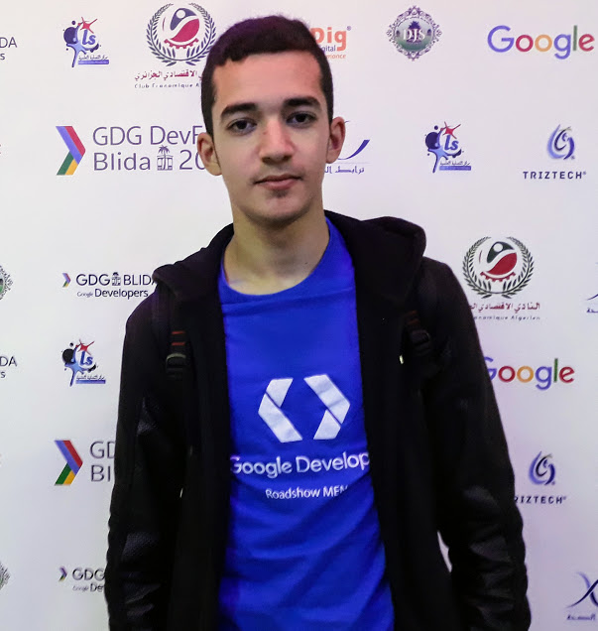
$whoami:
Tahar Amine ELHOUARI Penetration Tester
Chief Security Officer Taghellist Technology
CTF-Player SpeedTouch & Sudo_root

Slide 3
Terms:
CTF: Capture the Flag is a computer security or hacking competition which generally consists of participants doing anything they can, to reach the end goal, a "flag”.
Ethical Hacking: The art of locating weaknesses and vulnerabilities of computers and information systems (also known as Penetration Testing).

Slide 4


Slide 5
Let’s watch Something :-D

Slide 6
Ethical Hacking & Ethical Hacker:
They are just like terms used to describe hacking performed by a company or individual to help identify potential threats on a computer or network.
An ethical hacker attempts to bypass the security system and search for any weak points that could be exploited by malicious hackers. This information is then used by the organization to improve the security, in an effort to minimize or eliminate any potential attacks.

Slide 7

Hacker Types:
White Hat: White Hat hackers are also known as Ethical Hackers. They never intent to harm a system, rather they try to find out weaknesses in a computer or a network system as a part of penetration testing and vulnerability assessments.
Black Hat: Black Hat hackers, also known as crackers, are those who hack in order to gain unauthorized access to a system and harm its operations or steal sensitive information.
Gray Hat: Grey hat hackers are a blend of both black hat and white hat hackers. They act without malicious intent but for their fun, they exploit a security weakness in a computer system or network without the owner’s permission or knowledge.

Slide 8
What are the skills needed to be an ethical hacker ?!

Slide 9





Slide 10
How to learn Ethical Hacking ?

Slide 11
Play CTFs.
Read books.
Watch tutorials & courses.
Join forums, websites and groups.
Network with people & make friends.
Attend events (Conferences.. Workshops..).
Pass certifications & trainings.
Let google be your friend and use it everyday.

Slide 12





Where to learn Ethical Hacking?

Slide 13






Ethical Hacking Certifications:

Slide 14





Jobs & Positions:
Information Security Engineer.
Information Security Architect.
Cyber Security Researcher.
Bug Bounty Hunter.
IT Security Consultant.
IT Security Analyst.
Penetration Tester.

Slide 15


Slide 16
What are CTFs?
Hacking/Security Competitions.
Solve challenges.
Capture the Flag (flag.txt).
Earn points.
Get high rank.
Win money, gifts, jobs.

Slide 17
CTF Types:
Jeopardy: It has a couple of challenges (tasks) in range of categories. Teams can gain some points for every solved task.
Attack-Defense: Another interesting kind of competitions. Here every team has own network(or only one host) with vulnerable services. A team has time for patching services & vulnerabilities and then develop exploits and toolkits to attack other hosts.
Boot2Root: boot2root CTFs, are just a set of vulnerable machines that simulate the real world scenarios. It can be exploited following different techniques until you get access, escalate your privileges and get the flag.

Slide 18
FLAG
SpeedTouch{Sud0_r00t-Jun10r_T34M}
SpeedTouch{SSBhbSBhIGZsYWcgOi1QIA==}
SpeedTouch{73902328488538f9c850375d2fbd2511}

Slide 19
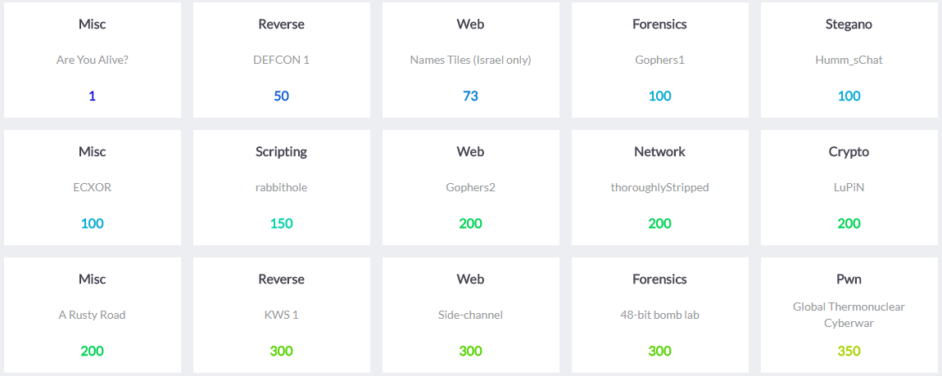
Jeopardy CTFs:

Slide 20
Jeopardy CTFs – Challenges:
Misc: Miscellaneous/Mixed.
Stegano: Steganography.
Network: Networking.
Forensics: Digital Forensics.
Web: Web Security/Web Hacking.
Scripting: Scripting/Programming.
Crypto: Cryptography/Cryptanalysis.
Pwn: Pwnable/Binary Exploitation & Analysis.
Reverse: Reverse Engineering/Malware Analysis.
Hardware: Electronics / Physical Security.

Slide 21
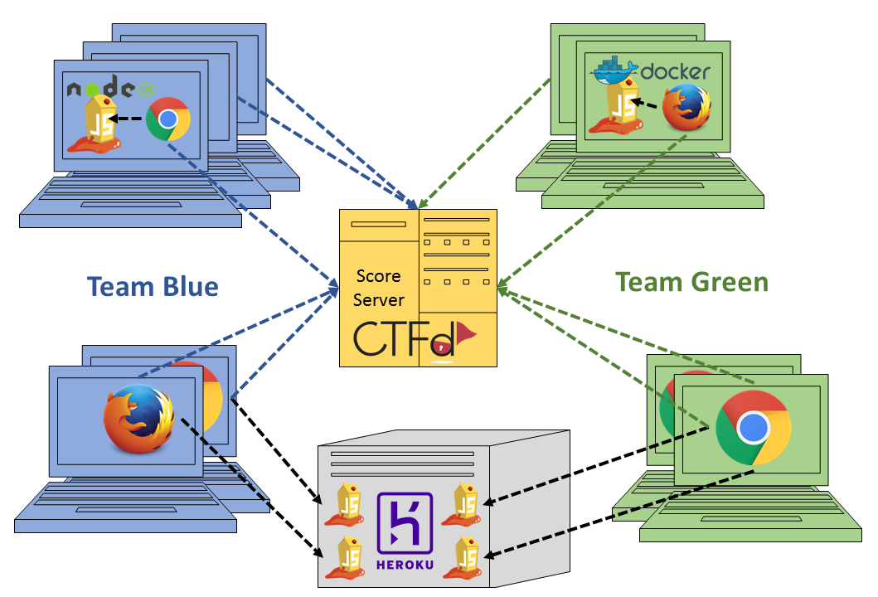
Attack-Defense – CTFs:

Slide 22
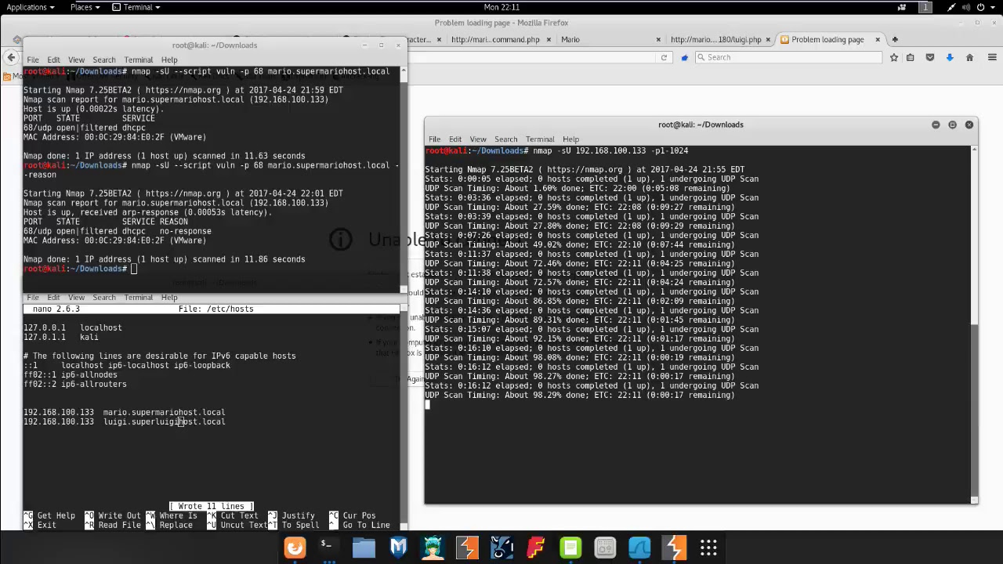
boot2root – CTFs:

Slide 23

Why CTFs?
Fun.
Challenging.
Gain experience.
New knowledge.
Develop skills.
Job offers.

Slide 24
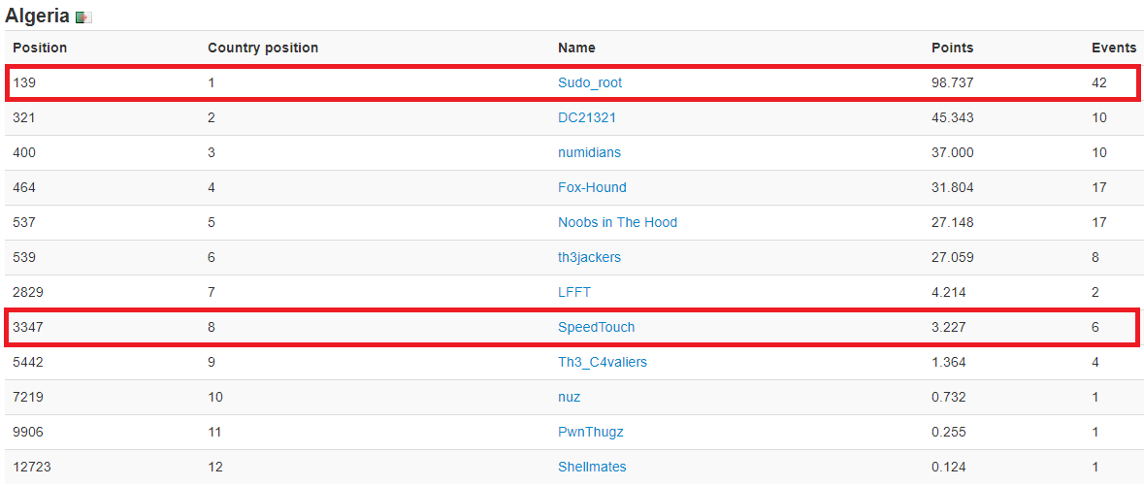
CTFs in Algeria:

Slide 25






How to learn & where to start doing CTFs:

Slide 26


Slide 27
#Ask_ME

Slide 28

You can find me on:
LinkedIn: /in/mrtaharamine
Twitter: @MrTaharAmine
Facebook: Tahar Amine ELHOUARI
YouTube: Tahar Amine ELHOUARI
Website: www.TaharAmine.me
Email: TaharAmine@tuta.io

